Slide 1
Design Develop Deploy Project Portfolio
David Cain, Nikolai Valkamo, ROWAN CLARK, CHRISTOPHER BOCZKO, LAWRENCE GIBSON

Slide 2
DESIGN PHASE

Slide 3

Brief
Consider all aspects of your life as a student. What aspects could be improved through the introduction of a digital service. Note that sometimes the introduction of a poorly designed digital service can make the experience worse, and some successful digital services rely on face-to-face interactions in addition to digital support.

Slide 4
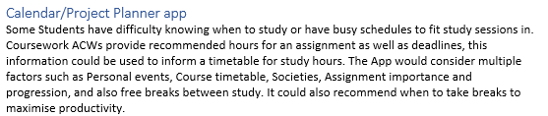
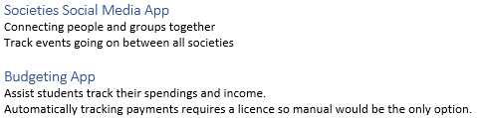
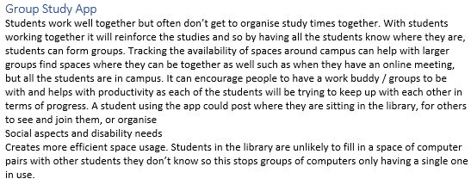
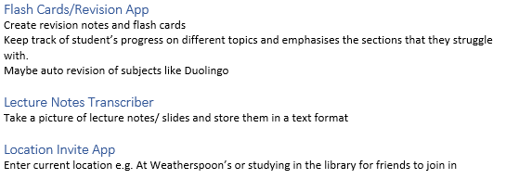
Brainstorming Ideas

Slide 5
Recipe Thesaurus
University brings a diverse range of students together and there is one common theme between each and every one of them, and that is the desire to eat food. It’s a requirement to live however they all struggle to cook and keep track of the food they eat. There is no skill, no flavor, no passion when it comes to cooking. This comes around because students have never received any teaching from their parents, this leads to them knowing nothing in the kitchen and the extremely limiting timetables that the university push onto them. This app will assist students to decide, plan and prepare what to cook every day of the week. It will take into consideration what they currently have and can tell them what to buy the next time they go shopping. To further reduce the preparation time, it will also show them to steps needed and the kitchen equipment needed, everything is planned for them.
This app will bring forth a social aspect, with everyone being able to share and rate recipes of each other. They may even decide to invite them over to dine with them. Creating communities between students can bloom into amazing lifelong friendships between people that may never of met before. Developing friendships with others with common interests of food and culture from all sorts of backgrounds.

Slide 6
Personas
Using personas, scenarios, mind maps, begin to discover the stories surrounding your project. You should create Epics and linked / grouped Stories. You could start thinking about acceptance criteria

Slide 7
Persona Ideas:
Student:
Skilled, Unskilled, Wealthy, Poor, Time limited, Lazy, Interested
Different cultures and recipes
Social eater, non social eater
Fridge space
Equipment
Disability requirements

Slide 8
Ideas
What should the app consider:
Cooking ability
Weekly Budget
Allergies
Social aspects (eating with people/planning meals)
Cooking equipment
Fridge space
Nationality/food preferences

Slide 9
Personas
Discovering who would find our app helpful and who are target users are

Slide 10
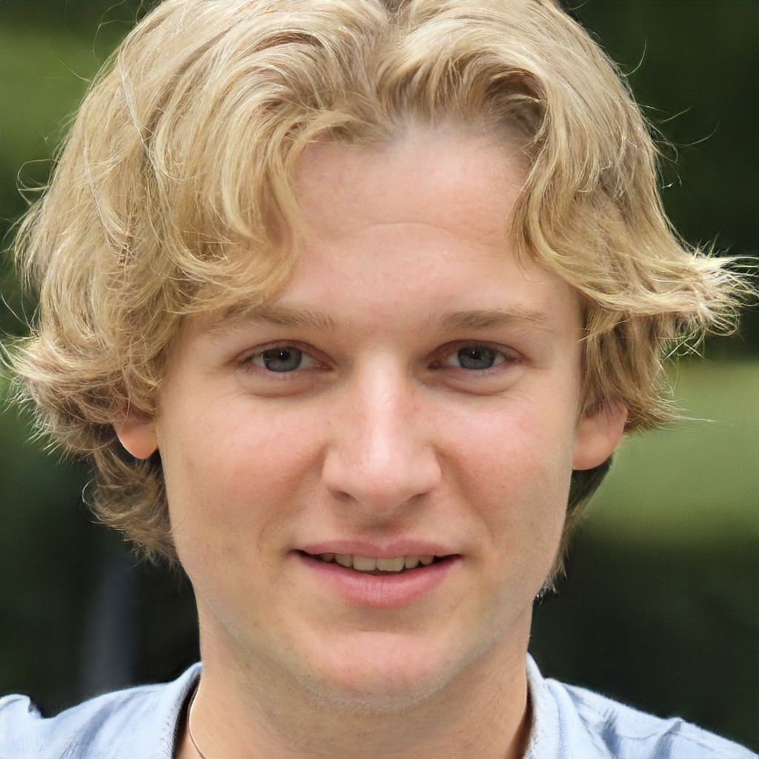
Jasper
20 year old Male
Unskilled Cook
White British
Goals:
Save money on food
Eating his favorite foods more often
Eating with his flat mates more often
Eating healthier and cheaper
About:
Jasper is a second-year student living in a house with 4 of his course mates with tight fridge space. He is very busy with assignments and lectures and doesn’t find time to cook or plan meals. He often buys whatever he can from Tesco but would like to eat his favorite foods more often. He has basic cooking utensils
Frustrations:
Meal Deals and takeaways are expensive
He doesn’t have time to plan meals or ingredients
Favorite Foods:
Soup
Salmon
Scrambled egg
Pasta
Dietary Requirements:
Cucumber and Melon allergy
Doesn’t like spicy food

Slide 11
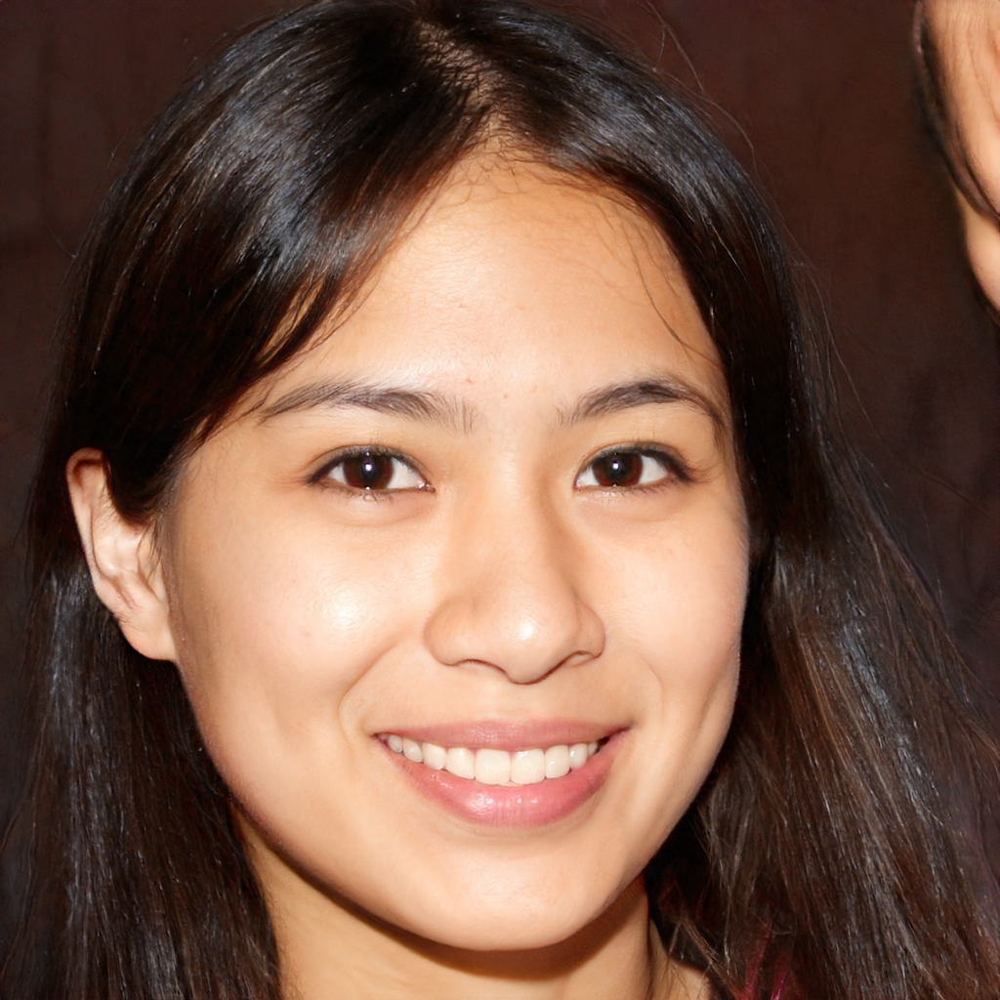
Tanika
19 year old Female
Unskilled Cook
International Student
Goals:
Learning to make, and eating her favorite foods from her home country
Sharing her culture with her friends
Finding English foods she likes
About:
Kade is an international student from the Philippines studying Environmental Science in her first year. During her first few months in the UK she has found it hard adjusting to the culture. She feels quite homesick and all her favorite foods cost a lot of money at restaurants far away from her. She wants to learn to make her favorite Filipino foods from home and introduce others to her culture.
Frustrations:
Cant get her favorite foods from restaurants
None of her friends have tried her favorite foods from home
Feeling homesick because of culture differences
Favorite Foods:
Adobo
Mechado
Leche Flan
Hotdogs
Dietary Preferences:
Tanika doesn’t like too much bread or pasta

Slide 12

Goals:
Finding extremely cheap recipes to make it to next Maintenace loan installment
Following Kosher diet
Keeping Jewish Sabbath and not buying food on Saturday
Fernando
23 year old Male
Skilled Cook
Jewish
Frustrations:
Very little money left to spend on food
Difficult to find Kosher foods at takeaways and restaurants
Finding alternatives to non-Kosher ingredients in recipes (e.g. Cheese in meat recipes)
Sites can bombard him with too many colours that don't help with his sight
About:
Fernando is in his final year of Law. He was born and raised in the UK by his Italian-Jewish parents and practices a strictly Kosher diet. He has spent too much of his Maintenace last month and has very little money left for the rest of the semester. He will need to buy the cheapest foods he can get to make it to his next Maintenace loan installment. Fernando is also partially blind.
Favorite Foods:
Chicken nuggets
Bolognese
Pizza
Shakshuka
Dietary Requirements:
Fernando only eats Kosher foods, this excludes pork, shellfish and mixtures of dairy and meat

Slide 13
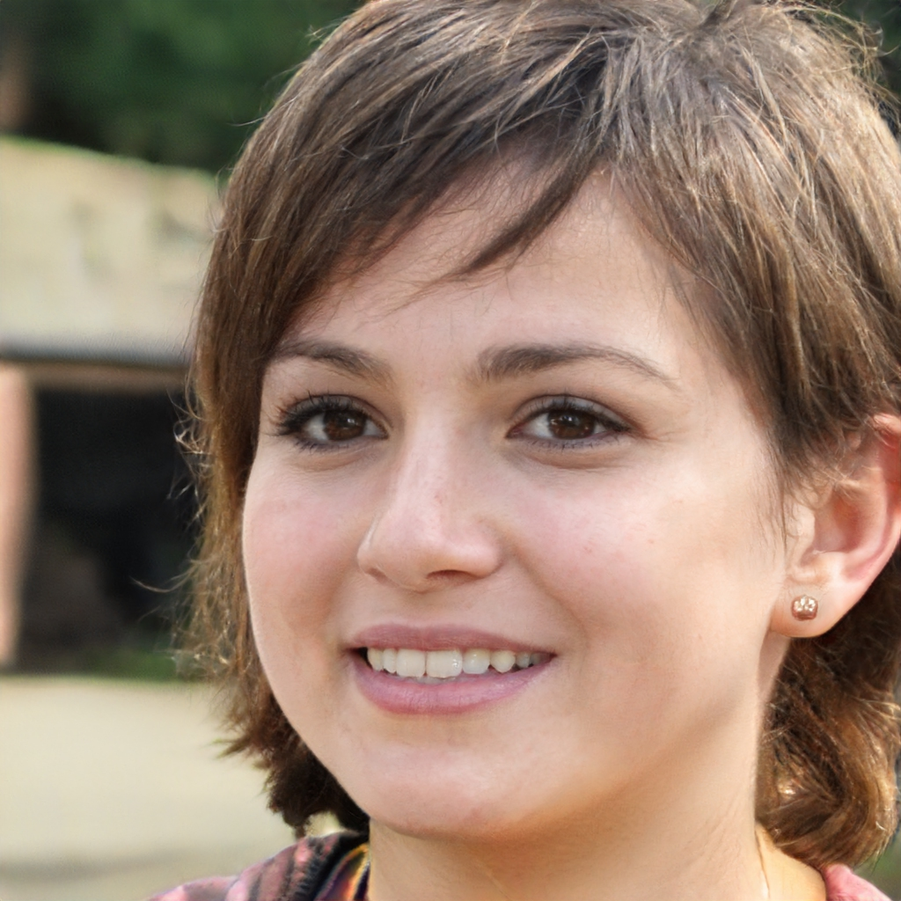
Caitlin
24 year old Female
Amateur Cook
White British
Goals:
Making friends
Sharing recipes
Discovering new recipes and foods
About:
Caitlin has just returned from a placement year and is now in a different year group with new people. She loves to cook and going out for meals with other people. However, since she is now a final year student all her friends have left after graduation last year. Now she needs to find new friends to cure the loneliness she is developing.
Frustrations:
Lonely
Doesn’t know many people still in her course
Favorite Foods:
Sushi
Pizza
Curry
Pumpkin Pie
Dietary Preferences:
None

Slide 14
Scenarios
What ways might people use the app

Slide 15
Scenario ideas
Maybe the app could recommend group meals so Fernando could save money by attending these?
Tanika posts a new recipe to the app and Caitlin organizes a social meal using it (requests her to cook it maybe?)
Fernando changes the budget to recommend cheaper food?
Jasper enters the food he has in his fridge to get recommended recipes to save going to the shops

Slide 16
Caitlin is always looking for new ways to prepare food with all sorts of different ingredients that she can obtain. Wanting to expand her love for foods she wants to try new things that she hasn’t had before. By looking at the large list of different recipes she may want to make the application can tell her to buy ingredients for the recipes. She can then make an even wider range of recipes that she and others can all enjoy together.
Shopping list planning / recommendation
Fernando is running very low on his maintenance loan. He's been using the app for a while to find kosher recipes he can make for cheap, but he's trying to save even more. He wants to eat out, but its expensive. He remembers that people on the app frequently post communal meal invites, and he decides to give it a go. He finds a posting for one, and checks it matches his dietary requirements. The posting says to bring £1 for entry. He registers to attend
Kinda like facebook events
Caitlin is feeling lonely and wants to meet new people. She's a passionate cook, so hosting a meal sounds like a fun idea. She creates a new post on the app inviting people to attend her flat next week with £3 for homemade pasta and a movie. In the next week she sees a few people register. On the day she makes enough for the people attending. She has a good time meeting new people and she makes a small profit from the entry fees.
Come dine with me social media type thing

Slide 17
Jasper wants to eat healthier, but he's kept pretty busy at Uni. He gives the app a list of foods he likes and a price range, as well as entering his allergies into the dietary requirements and the number of portions he wants by default. He also enters a few cooking tools he has. From now on, the app recommends recipes to Jasper based on his likes and dislikes. He can tick off 'not interested', favourite recipes he likes, or follow creators. He makes note of the ingredients for the recipes
Recipe tinder
Fernando has finally run out of money for food until he gets paid next week. He did a shop the other day, so he has a few ingredients in the fridge as well as some tins of food he hasn’t used. He isn't sure what recipes he can make from what he has so he opens his virtual fridge in the app and enters the ingredients he has. The app says that if he buys some coriander leaf, he can make one recipe, or if he buys some kidney beans, he can make 2 others. He decides to open up and read the one that needed coriander leaf, but just skips that one ingredient to make a similar meal.
Virtual fridge recipe filterer

Slide 18
Jasper’s timetable limits the amount of free time he has available for cooking and shopping. Walking to the shops takes too long and deciding on what to cook is equally time consuming. He doesn’t want to go shopping for a long while and so decide to eat with what he has left in the fridge and storage. He is content with any type of food as long as its edible and quick to prepare / eat. The app can know what he has currently and plan ahead what to eat today and for a few days with the ingredients available to him.
Dinner planning / ingredient considerations
Tanika wants to find out how to make Adobo like her mum makes her back home. She opens a search bar in the app and searches 'Adobo'. The app shows a few recipes from the internet and some recipes published by other users. She looks through them, but they all seem to vary slightly from how she remembers her mum makes it. Finally, she asks her mum to download the app to write the recipe. She adds her mum as a friend and follows her. She opens up the recipe her mum published, it's in grams but she hasn’t got a scale, so she asks the app to convert the recipe to equivalent cup and spoon quantities
Recipe search engine

Slide 19
Fernando likes browsing through the internet to look for new recipes to fit his requirements but is fed up with websites that have poor colour design as he can struggle to see things clearly at times. His current solution is looking through web browser extensions for themes, but these can be browser specific. Fernando uses the website's built in theme picker to choose a theme that suits him, and enjoys tweaking his environment to his liking, he will use the screen reader included to assist him at times.
Accessibility features
Tanika has been home sick and wanting to eat some delicious home cuisine. She sees one person hosting an event with home foods. She shows her interest and goes to it. She enjoys the meal with them and she makes a few friends. She can add the people she just met and their recipes to her own lists. She writes a review about the event giving her new best friends a 5 / 5 rating.
Friends, recipe sharing, Reviews

Slide 20
Epics

Slide 21
Fernando may not have enough ingredients for a full recipe but be willing to buy one or two things to complete one
Virtual fridge recipe recommendation
'Fridge' page
"I want to find recipes that suit my dietary requirements or match ingredients I have in my fridge"
Save dietary requirements
Filter recipes to reduce missing ingredients
Enter ingredients into virtual fridge section of app
"I want to connect with my friends and family on the app so I can see their recipes and what they like"
recipe search filters
'Following' page or just add friend's recipes to top of recommended?
Add a user to friends list
View friends
Search for users

Slide 22
Caitlin may only want to share recipes with friends or publish them to whole the world. She will want to tweak visibility for each recipe
"As an amateur chef, I want to write down my recipes and publish them for others to see"
Basic recipe creation and publishing
'cook book' page
Create and save recipe
Post a recipe
Set who can see the recipe
"As someone wanting to learn with the app, I want to search for and find recipes to follow"
recipe searching
Tanika may want to save a recipe to view later
'Liked' page
Open a recipe
Save a recipe
Search for recipe

Slide 23
Theme customising and site accessibility
"As someone who has trouble viewing, I want to be able to change how the app looks so I feel more comfortable"
Custom user themes / a theme repository
Low / high contrast views
Dark / light modes
Screen reader
Jasper doesn’t like spicy food. He may wish to save a preference against it
Recipe recommendations/ highlighted recipes
'Recommended' page
"I want to be recommended recipes I might like so I don’t have to spend time looking for them"
Save preferences
Filter recipes by saved preferences

Slide 24
Sharing recipes between people
"As someone wanting to find new people and share my food I want to connect with other people"
Events with other people
Sharing recipes
Events with people
“As someone with a low budget I want to be able to save my money while cooking and my time"
Recipe planner
Ingredients taken into consideration

Slide 25
Summary
By now we have discovered some functionality for our app.
We have recipe searching and a virtual fridge and preferences to filter out recipes that are more relevant to the user
We have also defined a recipe recommendation system that will consider user settings and additional functionality for social events and friends sections
A user can
Set allergies and dislikes
Publish recipes and view friend's recipes and events
Search for recipes or be quickly recommended recipes they might like based on their preferences
They can also save recipes to look at later

Slide 26
App pages layout
login
home
Fridge
Search (for recipes or people)
Recommended
Cookbook (saved recipes and create recipes)
People (friends posts and events)
settings

Slide 27
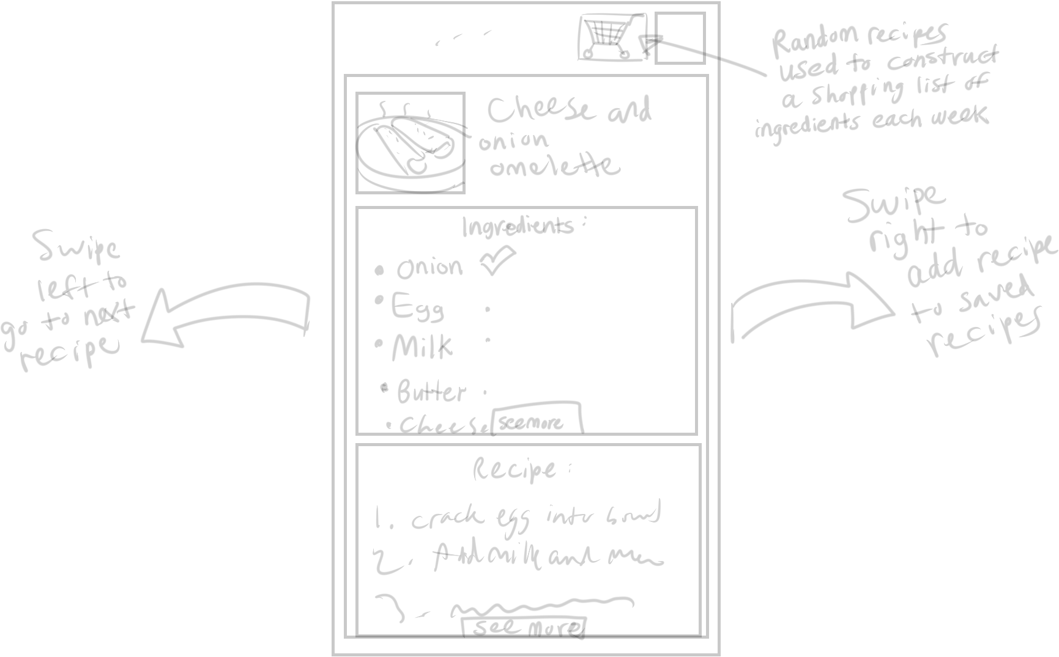
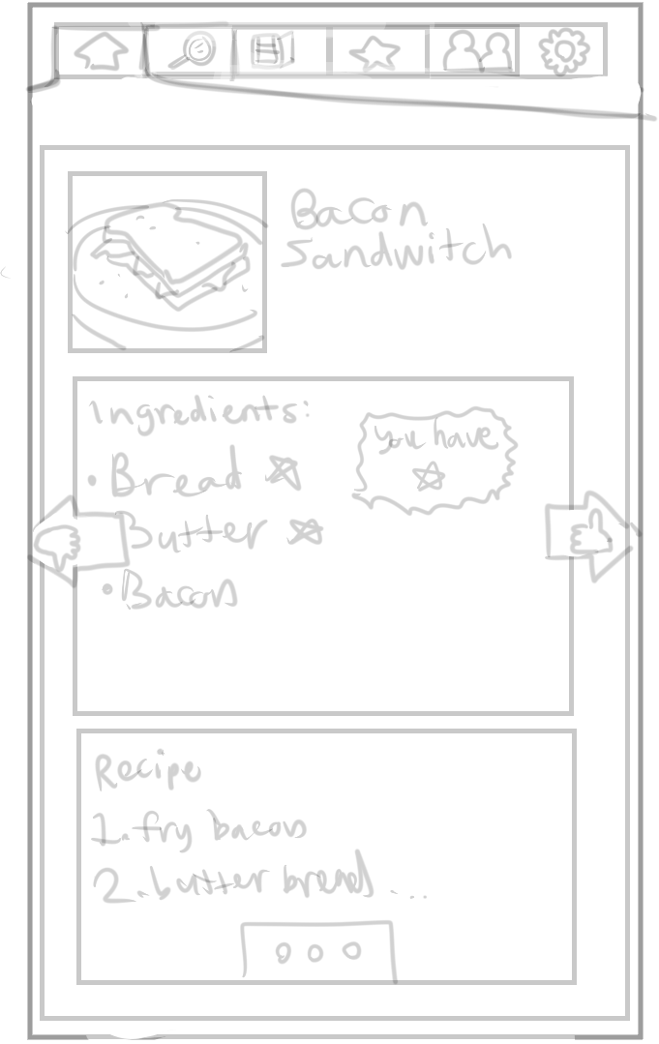
Sketches of the app (pages or UI features)
Set shopping list price limit?
Construct shopping list based on liked recipes
Shopping basket constructed each week based on ingredients for recipes you might like
Recommended page makes finding a recipe quick by swiping through one after another

Slide 28
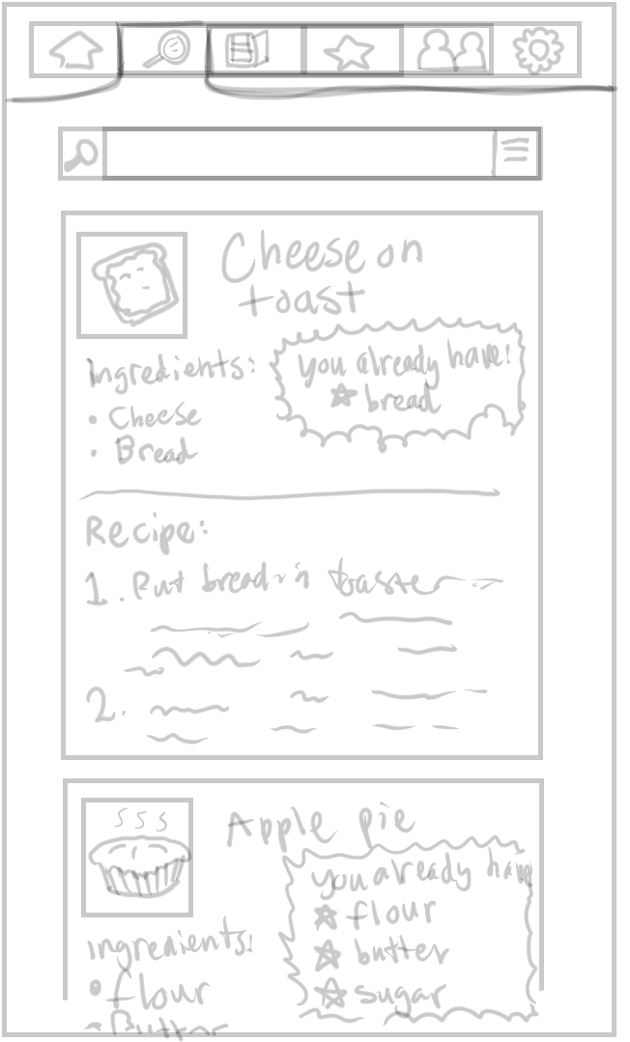
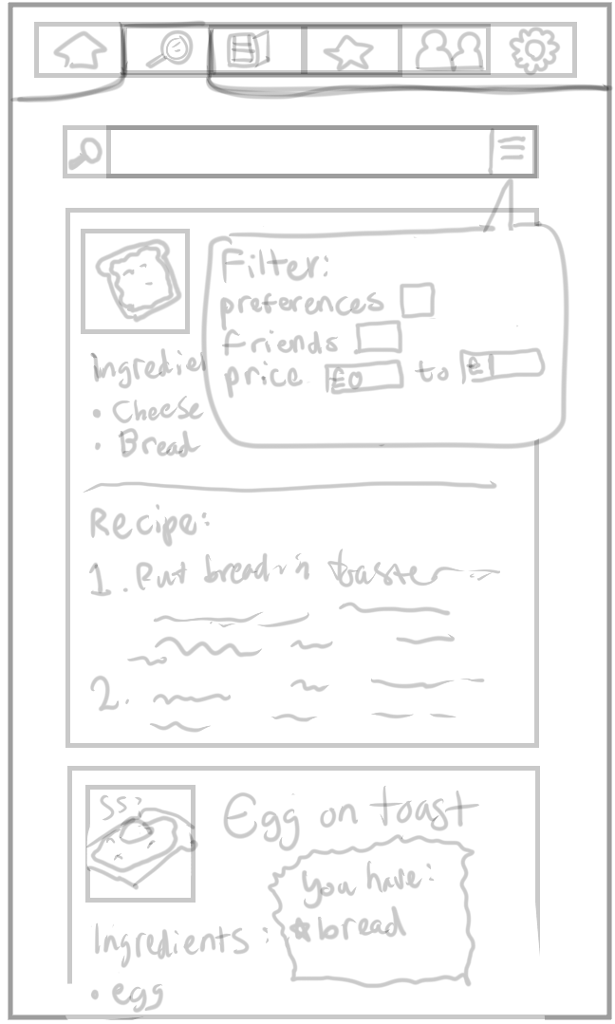
Recipes can be searched for
And various filters applied to results

Slide 29
Caitlin shared
Vegan Pumpkin Pie
1 can pumpkin puree
1 cup flour
1 cup sugar
...
...
Recommended for you
Soup
1 onion
1 carrot
½ cabbage
...

Slide 30
Backlog / Tracking

Slide 31
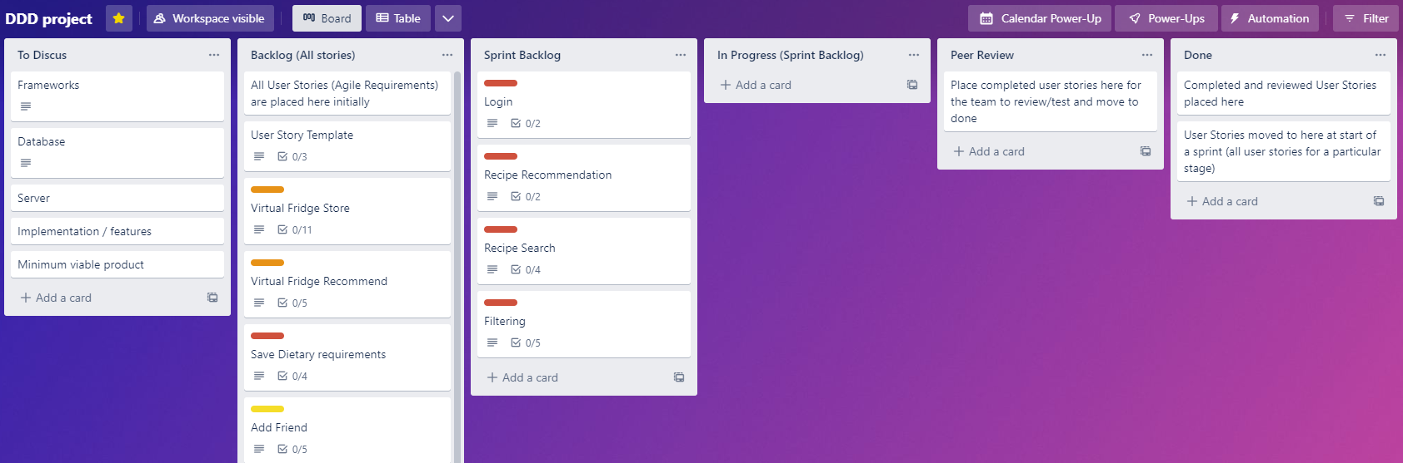
Red – high priority, Orange – medium priority, yellow - low priority
Our user stories and their acceptance criteria and user scenarios have started to be added to our trello board:

Slide 32
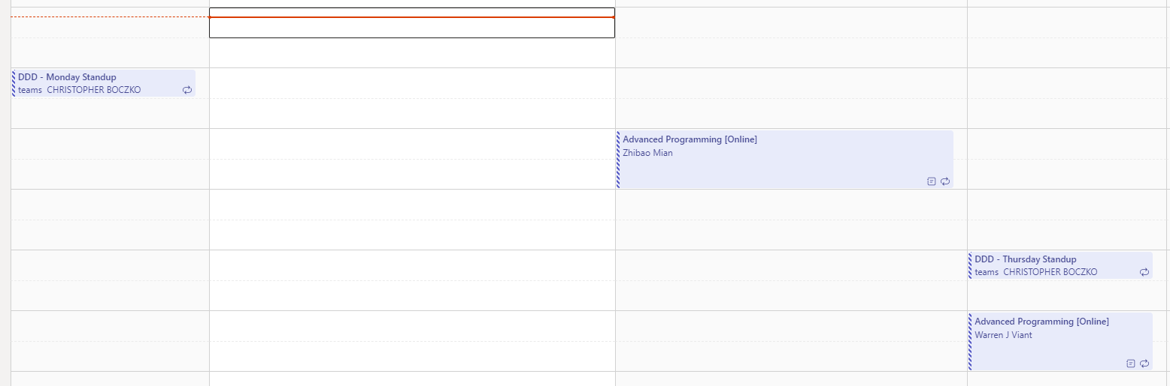


We have been holding twice weekly standups on teams to discuss the project as well as the weekly labs

Slide 33
What features do most students need and what features do only some need?
Most important features?
Searching, finding and saving recipes
Being recommended recipes
Saving money and time with auto shopping list
Not all student struggle with money or want the social aspect of the app, thus these features will be a low priority and probably not added in our earliest sprints
Other features like searching for recipes are a core functionality of the app and it would be a good idea to include them in alpha

Slide 34
Feature Prioritisation
As seen in the Trello board on the previous slides, there are a lot of features that are planned. It is however not realistic that we will complete all of these, especially in early sprints, there may be some that will not be completed fully and even some that we will decide to abandon as we develop the solution and receive feedback. To reach a minimal viable product stage without being completely overwhelmed, we have prioritised a few features to implement to a basic standard
Login - A central point of the solution is that each user has their own account with settings, recipes and contacts etc. Without this the site
Recipe Searching – One of the core functions of the app is finding recipes. One main way to do this is through a keyword search
Virtual fridge – Each user can add and remove items of food they have in so that they will be recommended recipes that contain that item, aim to curb unnecessary purchases while the user has food they can use in and prevents food waste, can also be shared with other users
Saving of dietary requirements – dependant on login, essential to filter out recipes that may contain allergens. Can also be used to let friends know what they're allergic to so group cooking becomes more manageable

Slide 35
GitHub Project Management
GitHub allows for developers to work on software simultaneously. Keeps track of different versions and all the changes that have occurred.
Separating features using branches
Splitting each feature into its own branch helps development
Streamlines development and ensures that no clashes occurs during development
Feature branches can be merged back to the live product once they have been verified

Slide 36
Estimation and prioritisation needs doing

Slide 37
ALPHA PHASE

Slide 38
The following is the project planning side:

Slide 39
Sprint 1:

Slide 40
David
For the alpha sprint I will be working on designing and creating a database which will be added to Chris' Back end of the app

Slide 41
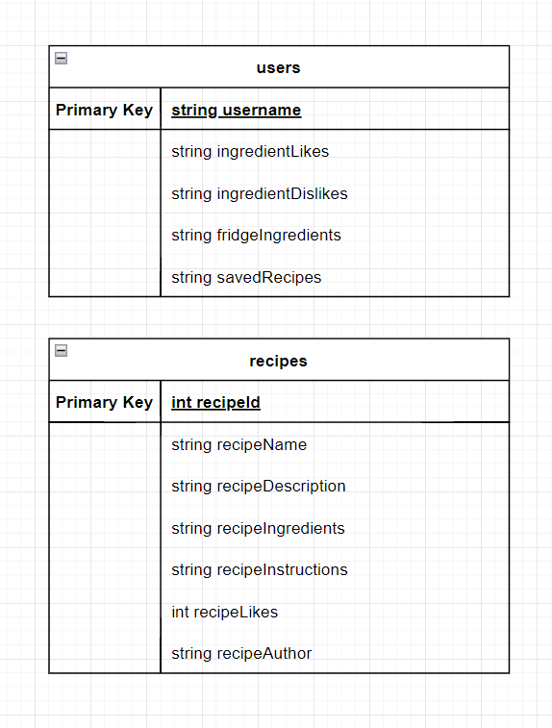
Database Design
Initially, we need the database to store users and recipes. Here was my initial idea: A users table and a recipes table with columns for associated information and one to many relationships implemented as just a comma separated list.
For our app to function, we will need a database to store user info and recipes, as well as other information.
A few features like friends lists and social posts will be implemented in later sprints so we will not be implementing tables necessary for them, but the database design anticipates some features which may be added in the next sprints.

Slide 42
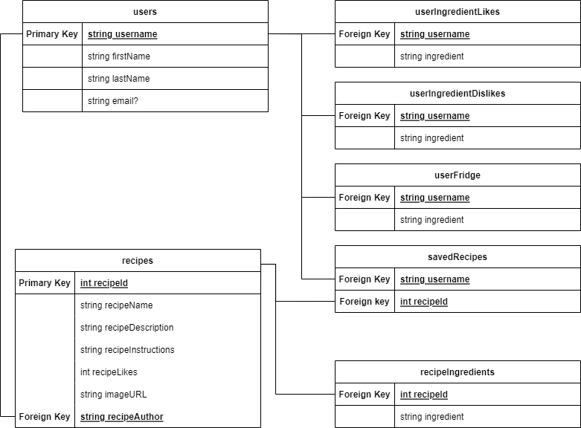
Database Design
After finishing the initial database design I had it peer reviewed at one of our scrum meetings.
The team decided that it would be better to normalise the database so one to many relationships would be on separate tables.
I modified the schema and at a second peer review everyone was happy so I moved to writing the script to create the database and fill it with test data
Speaking with Chris who was working on the infrastructure for our app, he recommended Microsoft SQL Server Management Studio and explained how everything would work on his end.

Slide 43
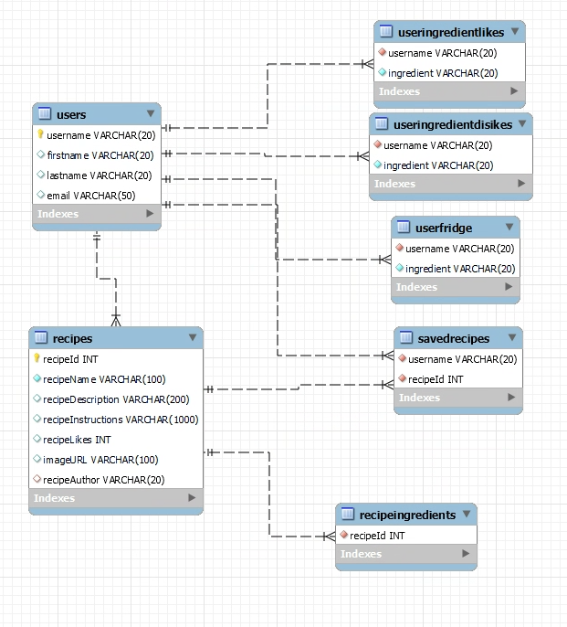

Slide 44
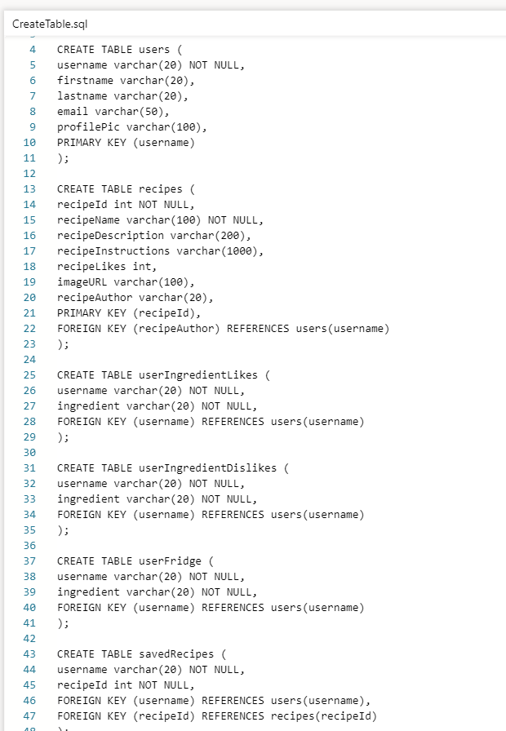
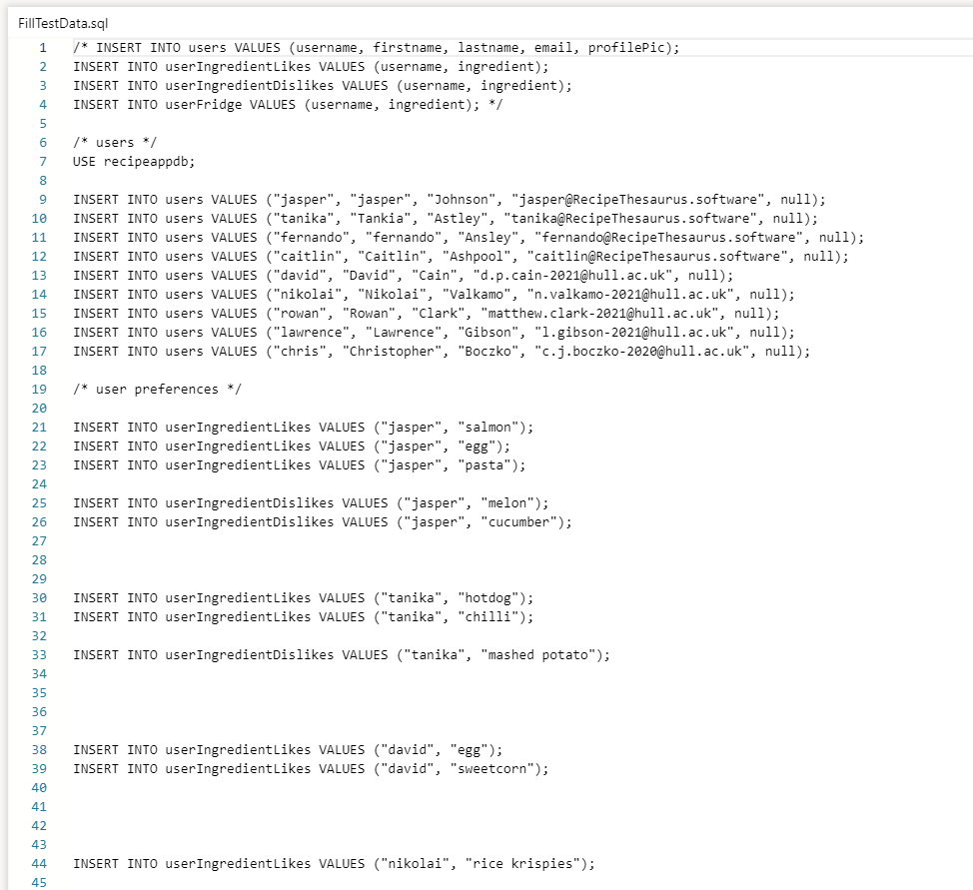
Scripts

Slide 45
Database Implementation
After I finished the schema and script, I spoke to Chris, who had set up the host for the SQL database. Using Microsoft SQL Server Management Studio I created the actual database ready for our next sprint. I then pushed my scripts to GitHub. This concluded my side of the first sprint

Slide 46
Nikolai

Slide 47
GDPR
Laws that outlines how a persons data is used processed and stored
Users must accept for their data to be processed
How information is used must be clearly explain
We will be storing user emails as a way to identify unique users and associate them with an internal account. Location can also be used to quickly find nearby shops and the prices of ingredients

Slide 48
Cookies
Operations cookies
Recognising you when you sign-in
Keeping track of items stored in your shopping basket.
Keeping track of your preferences such as language and accessibility needs.
We will only be using operational cookies to help with the user experience while using the systems provided.

Slide 49
Chris

Slide 50
Git, infrastructure and oauth
Implemented git flow within the github repo, including actions and secrets required for deployment
Build initial front / backend infrastructure
Created required resources and deployment scripts
Implemented oauth within asp.net using jwt – with session stored in cookies
Created SQL Server, database and github actions deployment ready for David / Lawarence SQL scripts

Slide 51
Rowan, Lawrence

Slide 52
Testing
Testing is configured with Selenium, from now on, each new feature where possible will be tested with Selenium and ran automatically via a GitHub Actions workflow. Currently there are tests for checking the deployed site is up, a bad login and a good login. Credentials are setup via GitHub Secrets and environment variables to ensure we are not committing sensitive information at any time. Code has been refactored as tests are added to create reusable components that should make code more maintainable should others wish to work on the tests

Slide 53
Code Review and Git
In addition to setting up automated tests, we have also been handling code review, managing pull requests from mostly Chris with regards to the deployment of the code, to ensure a minimal amount of poor or buggy code is merged into the development branch. Also ensured the following of the Git Flow branching standard.

Slide 54
We need a slide for our retro, what weve accomplished in the sprint and the next plan (show trello board and stuff)

Slide 55
Retro
What went well in the sprint?
We accomplished a user story, got login ready
Ready for further sprints/user stories
What didn’t?
Lack of documentation/knowing where some people are/communication
attendance
How do we improve in the next?
More engagement on teams saying what we are doing and estimating when we will finish or something
Attend meetings
Please add your thoughts so we can make a slide

Slide 56
Retrospective:
We had a retrospective meeting for our first sprint on Wednesday 01/03/23 where we discussed what went well and what didn't.
During the last sprint we completed the login user story and got most of the dependencies for our app sorted out, ready to start more complex user stories in later sprints.
We agreed that communication was an issue and that we need to make each other aware of what were doing and what we have done.
We also agreed that attendance was an issue with certain members not showing up to important meetings or being late.
We decided that we need to make sure to attend all meetings and communicate in the chat to ensure next sprints go more smoothly.

Slide 57
Sprint 2 Plan – Alpha Showcase
In the next sprint we allocated and estimated tasks that need doing:
David – making wireframes for user stories and creating a burndown chart
Nikolai – finish the cookies information carried over from the last sprint and move onto another task
Lawrence – Integrate Database into the app with queries and classes
Chris – Continue setting up infrastructure
Rowan – Help Chris with some infrastructure tasks and with implementing cookies

Slide 58
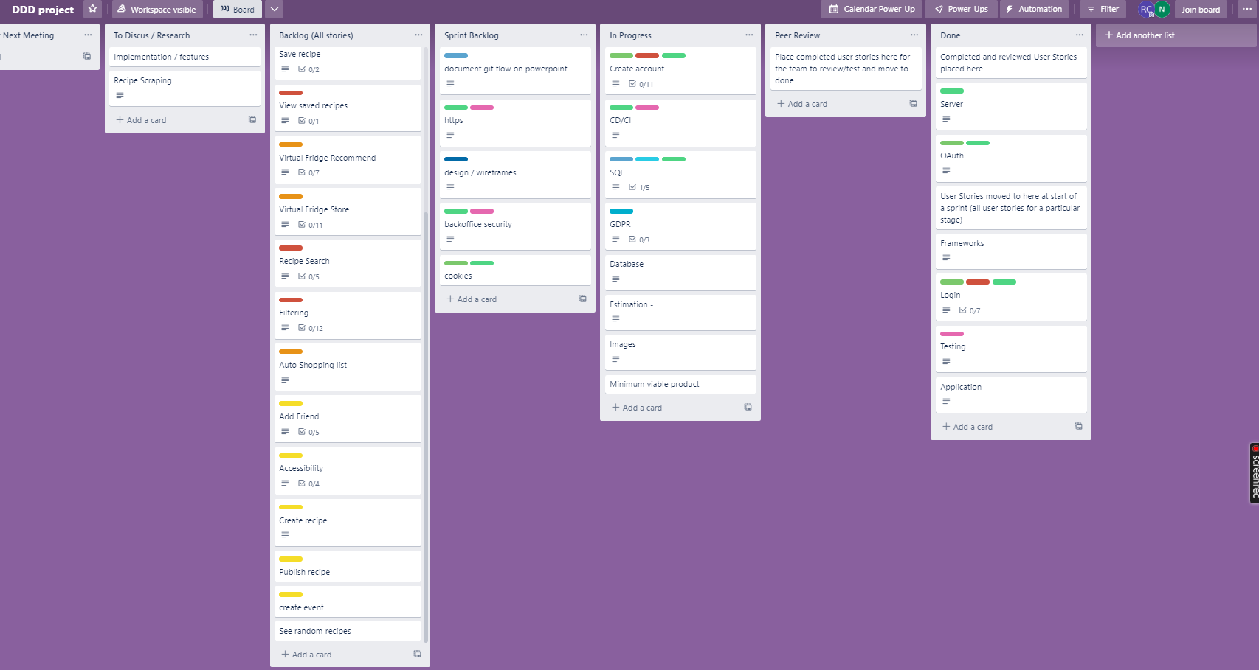
Current kanban board – start of sprint 2:

Slide 59
Sprint 2

Slide 60
David
For the SECOND sprint I will BE creating a Wireframe prototype

Slide 61
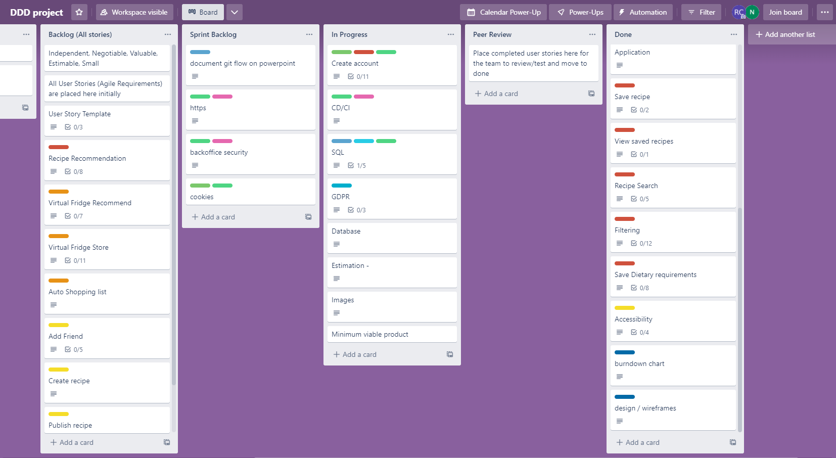
End of Sprint 2 Kanban board:
As you can see, some of our user stories are still in the backlog or In progress, so we will be discussing how we will estimate in future sprints to avoid setting too many tasks.

Slide 62
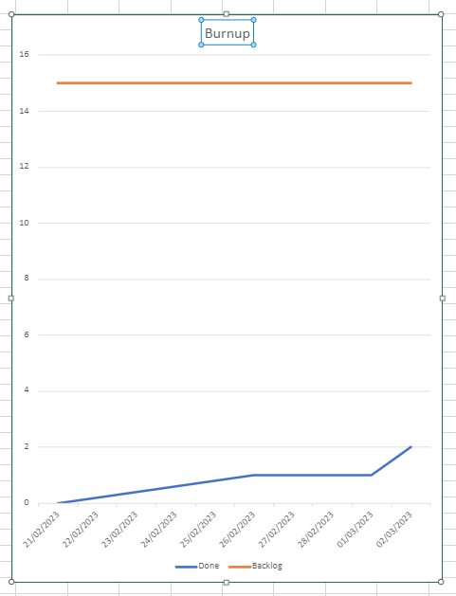
This burnup shows user stories prototyped in the alpha out of all user stories in the backlog. This is just as a done or not done but for later sprints we will base the burnup on estimation of backlog tasks as usual

Slide 63
John’s Feedback:
- Link user stories with epics
- Show epics being executed
- epics are the priority and user stories need to link to them
- Open with an epic and show it being executed
- estimation?

Slide 64
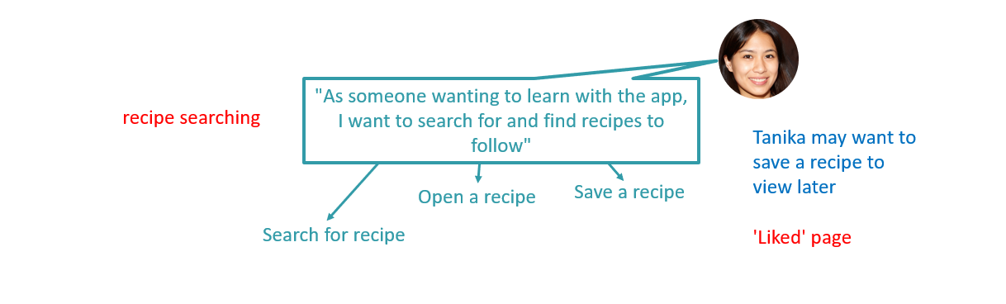
Tanika Wants to follow new recipes, she needs to be able to find, view, and save them easily to completely satisfy her as a persona

Slide 65
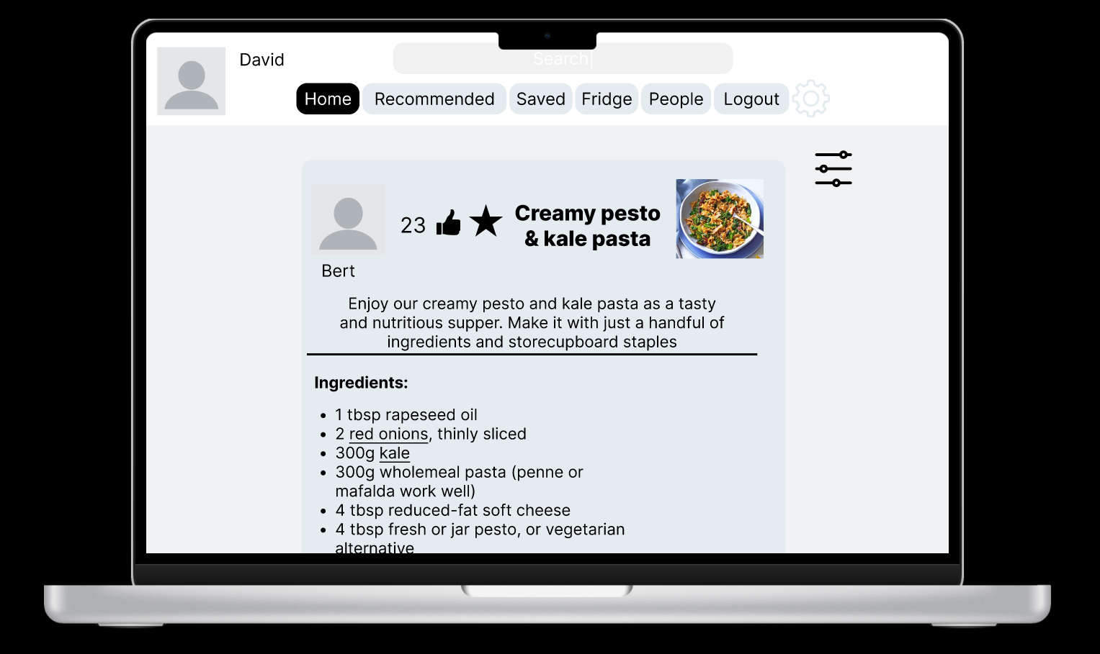
View recommended recipes on homepage

Slide 66
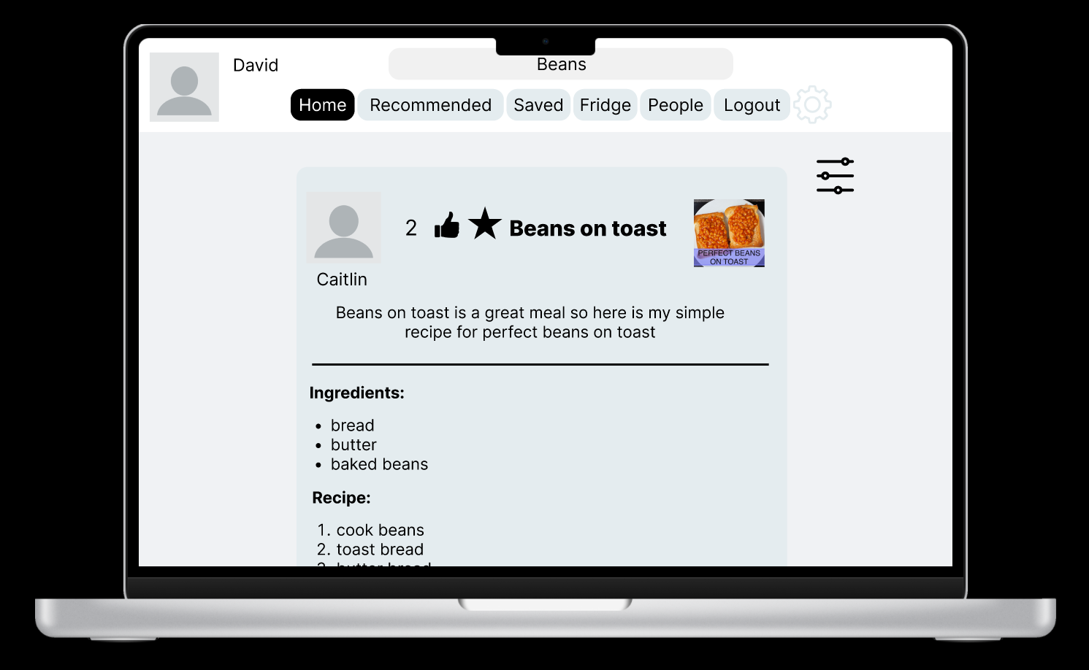
Search for a keyword in the search bar

Slide 67
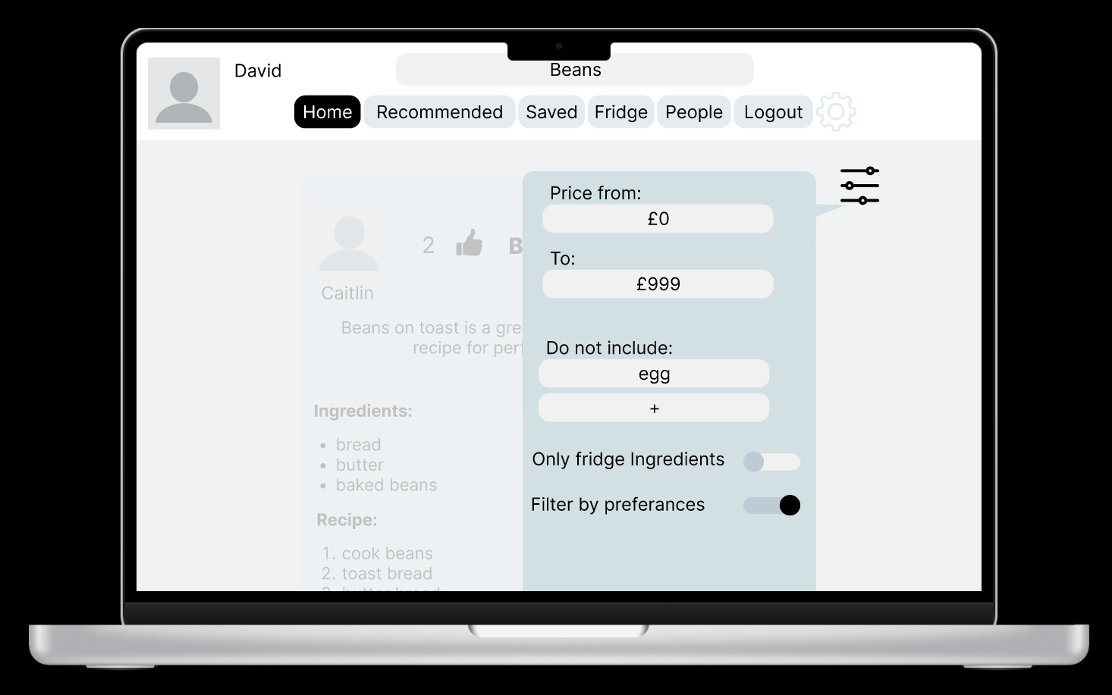
Or apply Filters to find the recipe youre looking for more easily

Slide 68
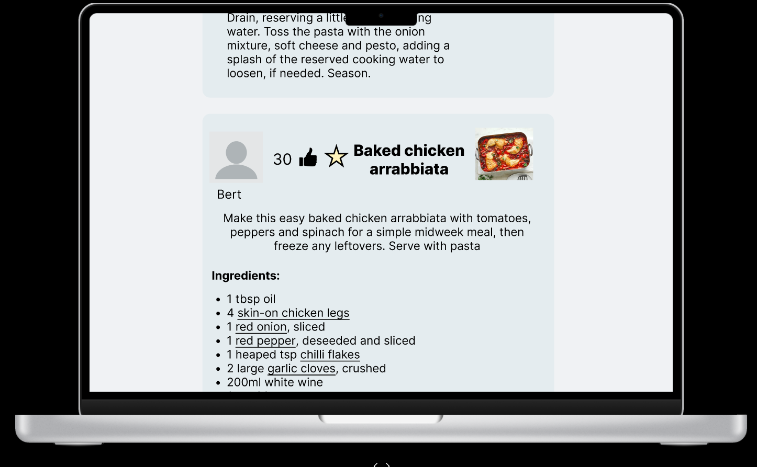
Save a recipe you like

Slide 69
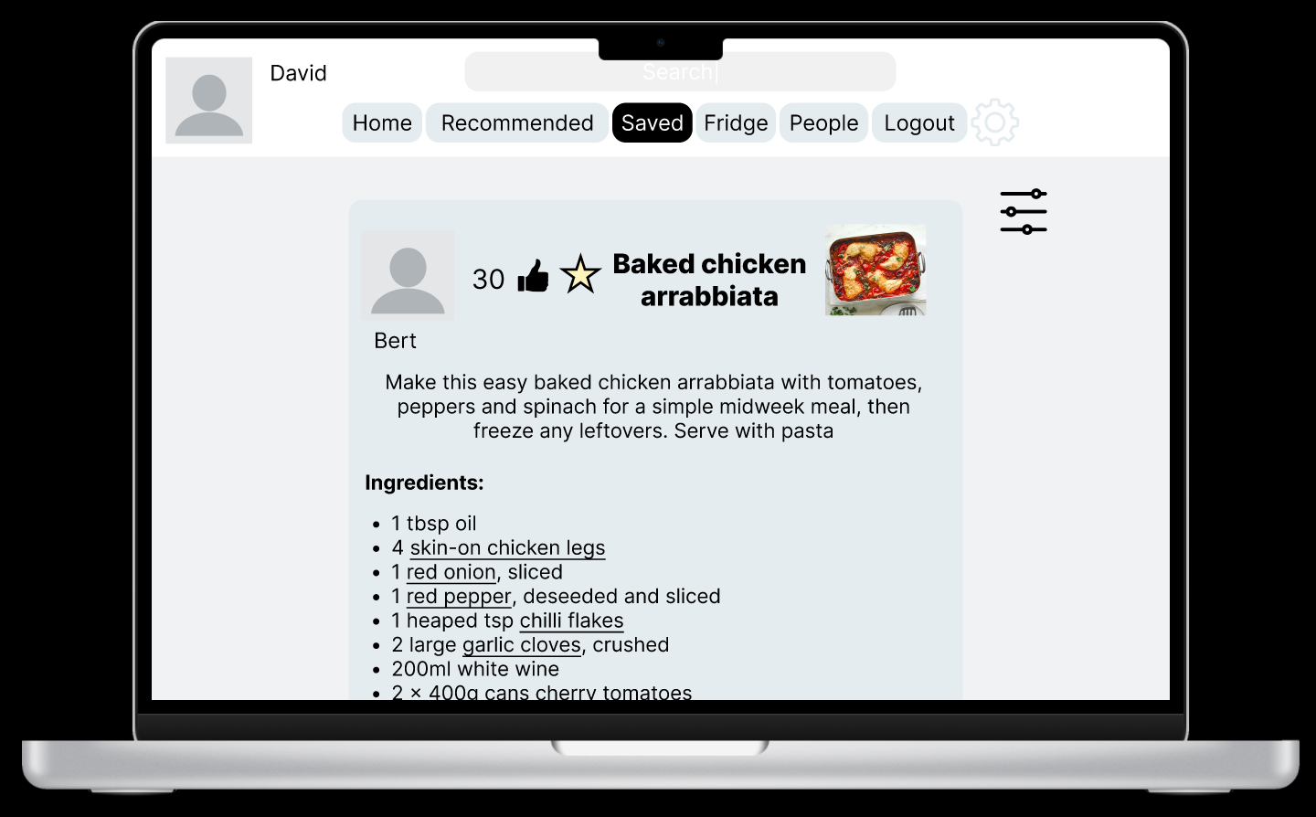
And view it in a saved recipes section to follow it later

Slide 70
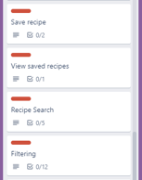
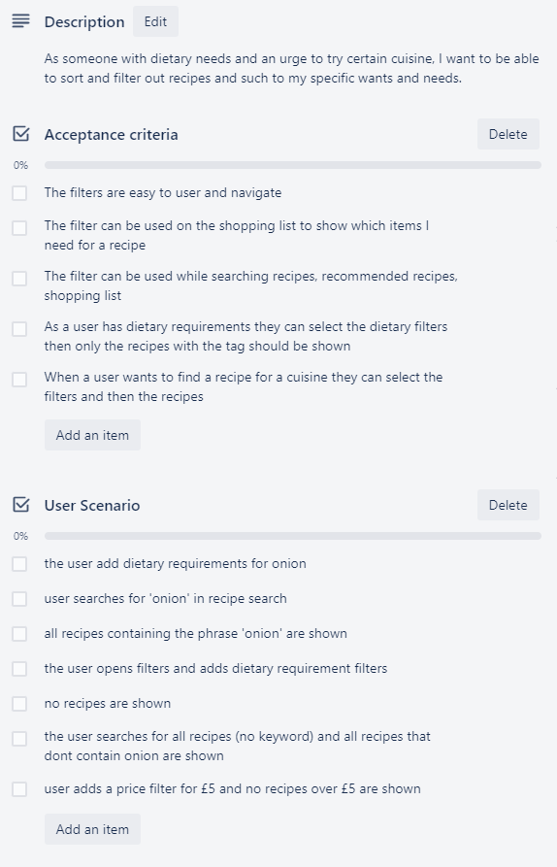
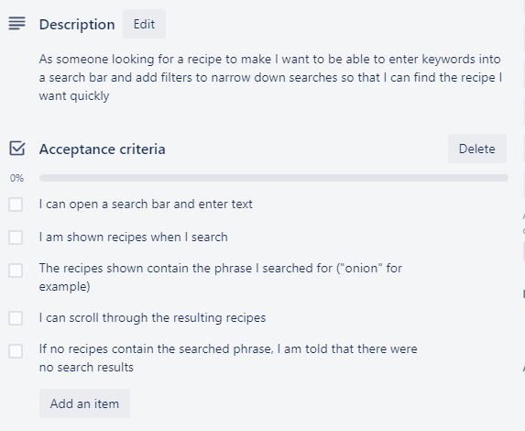
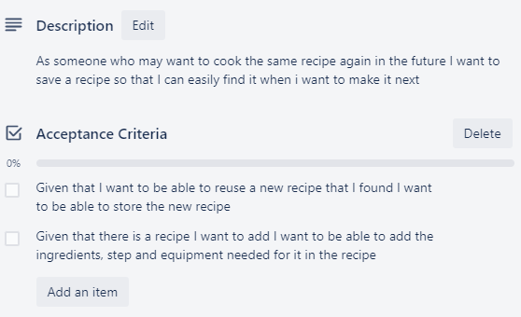
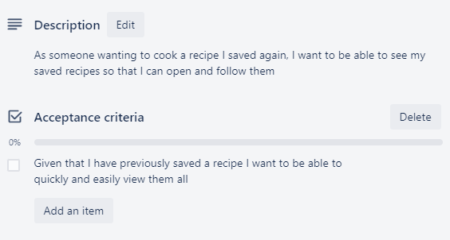
Include acceptance criteria in prototype showcase
4 user stories for Tanika have been prototyped to show what a fulfilled acceptance criteria will look like:

Slide 71
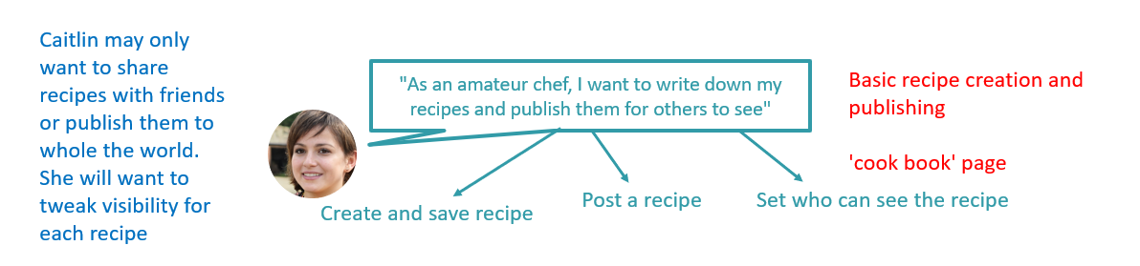

Slide 72
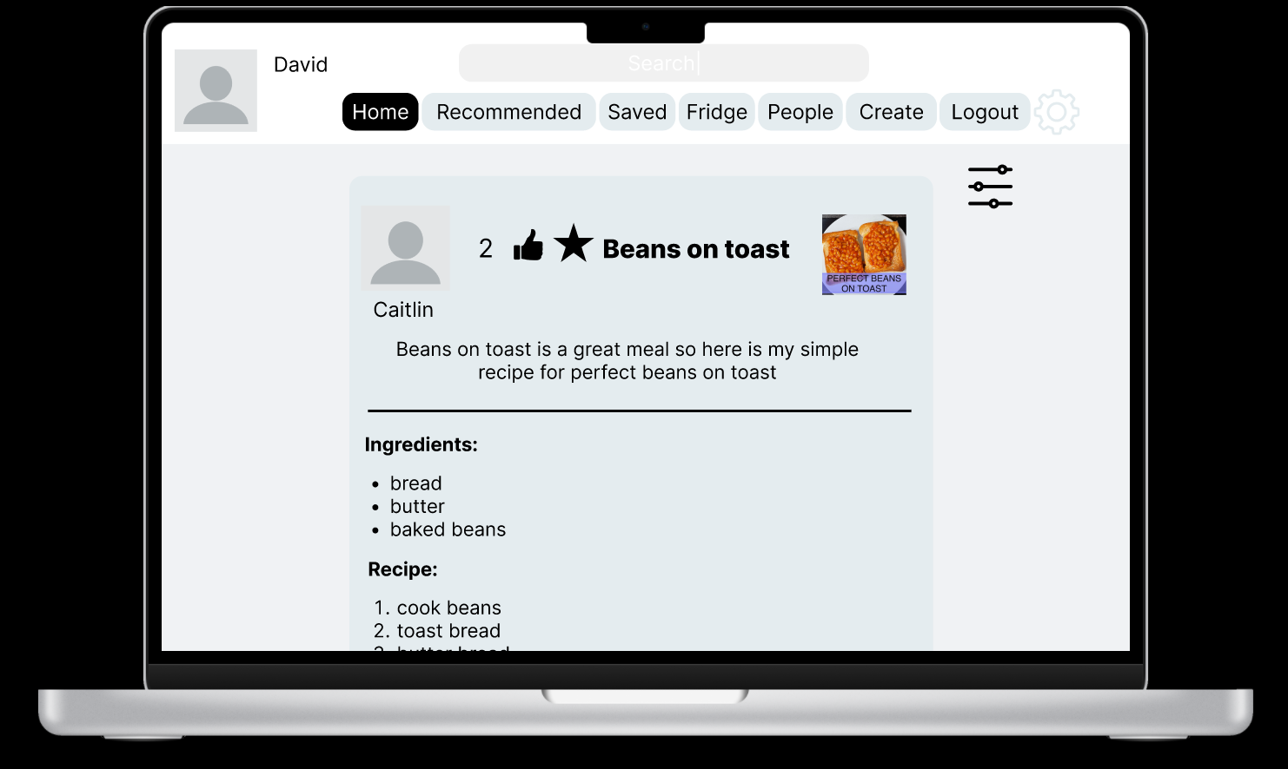
Click on create to make a recipe

Slide 73
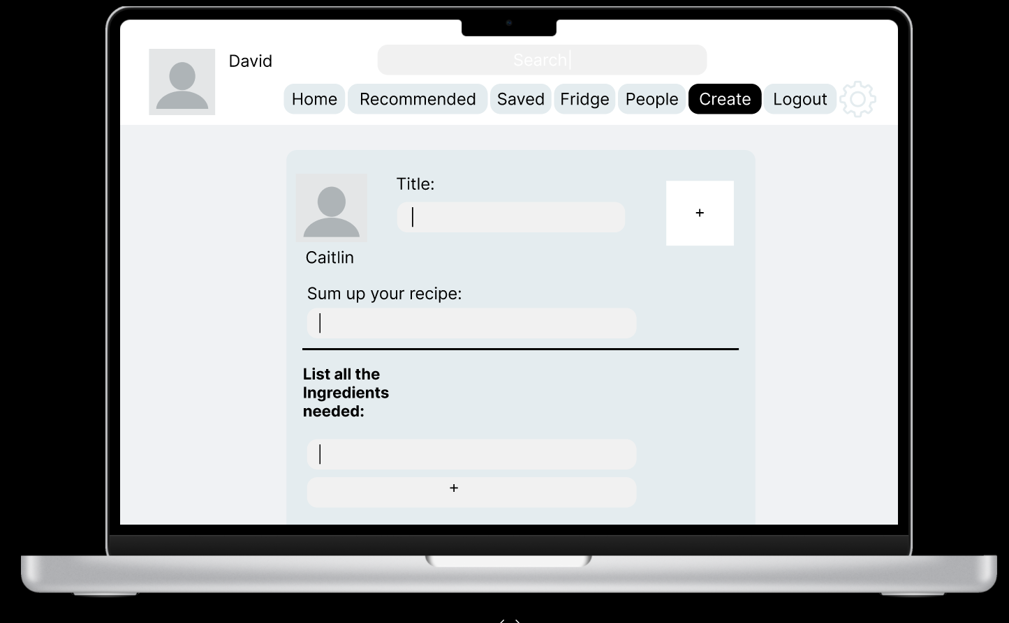
Recipe Template to fill in

Slide 74
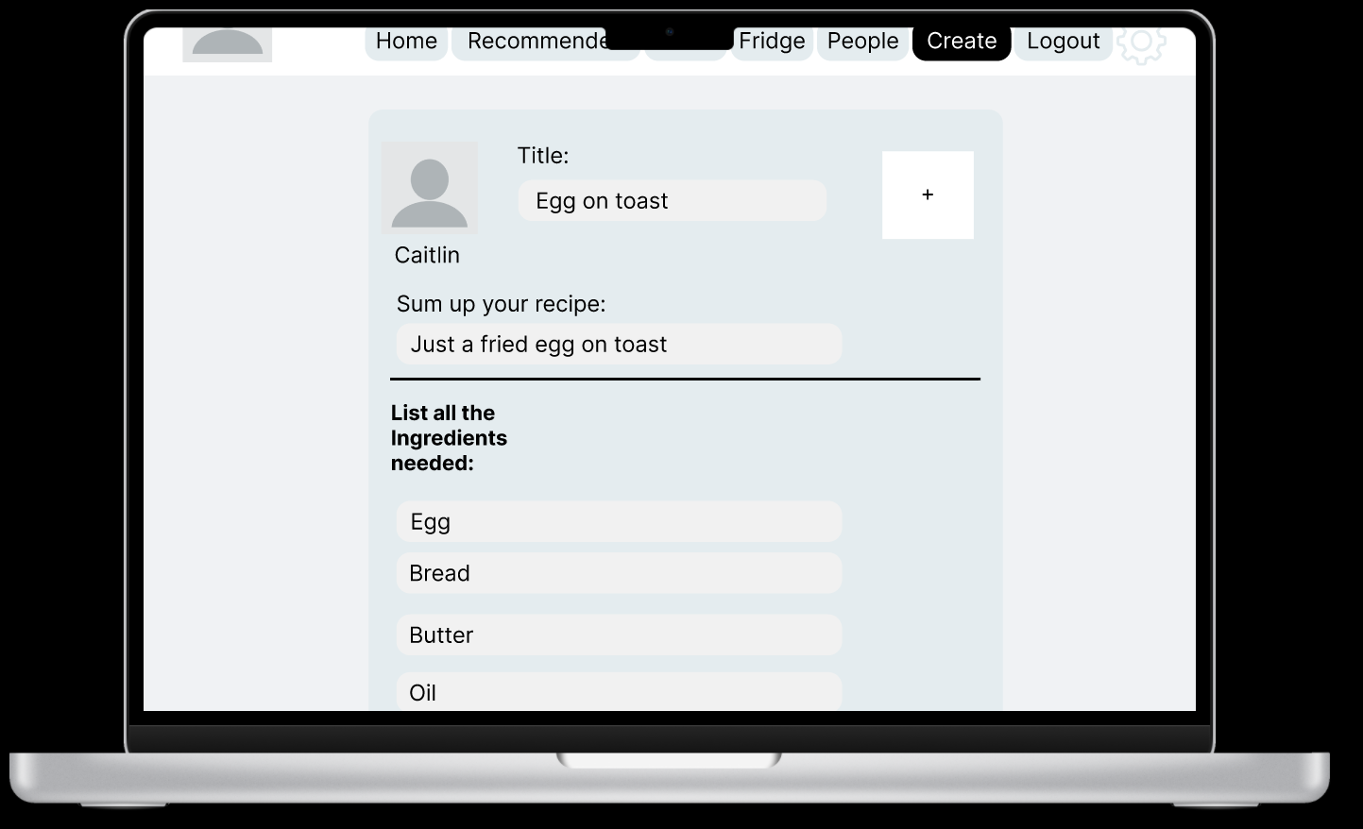
Just write text in the spaces provided
*We may want to add quantities*

Slide 75
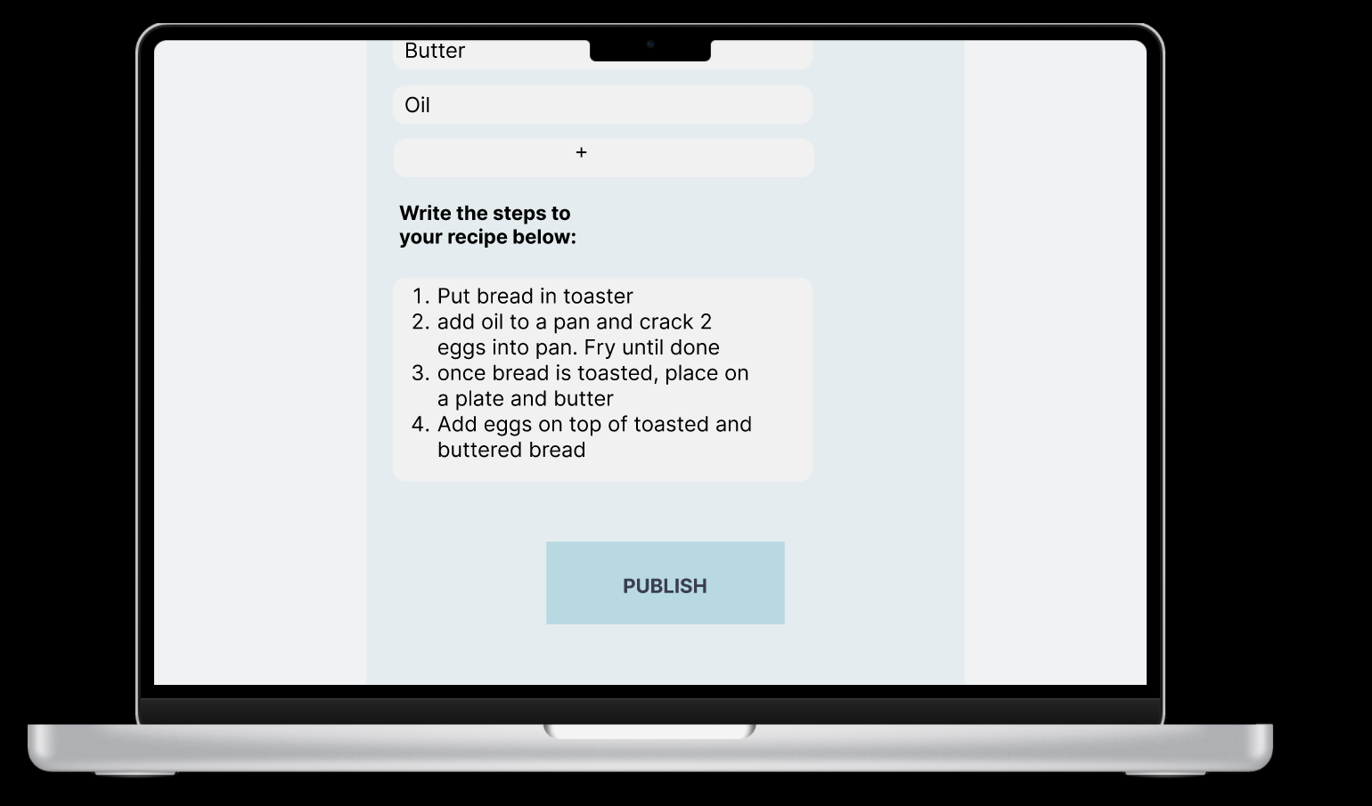
Click publish

Slide 76
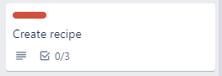
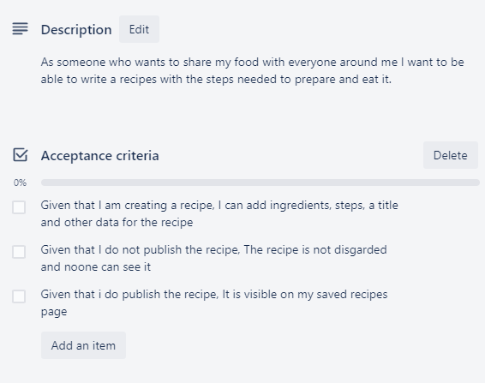

Slide 77
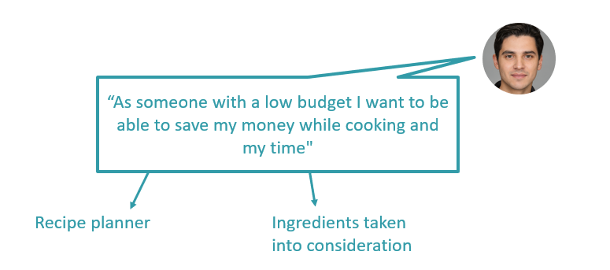
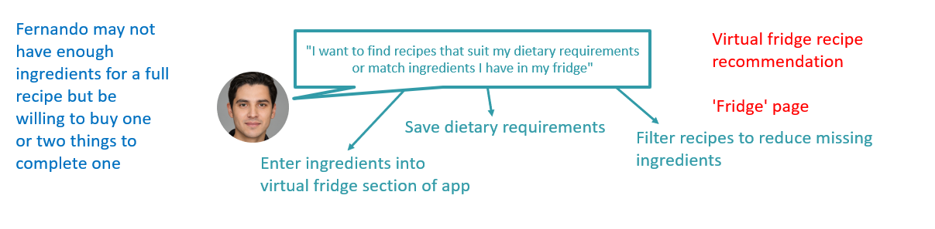

Slide 78
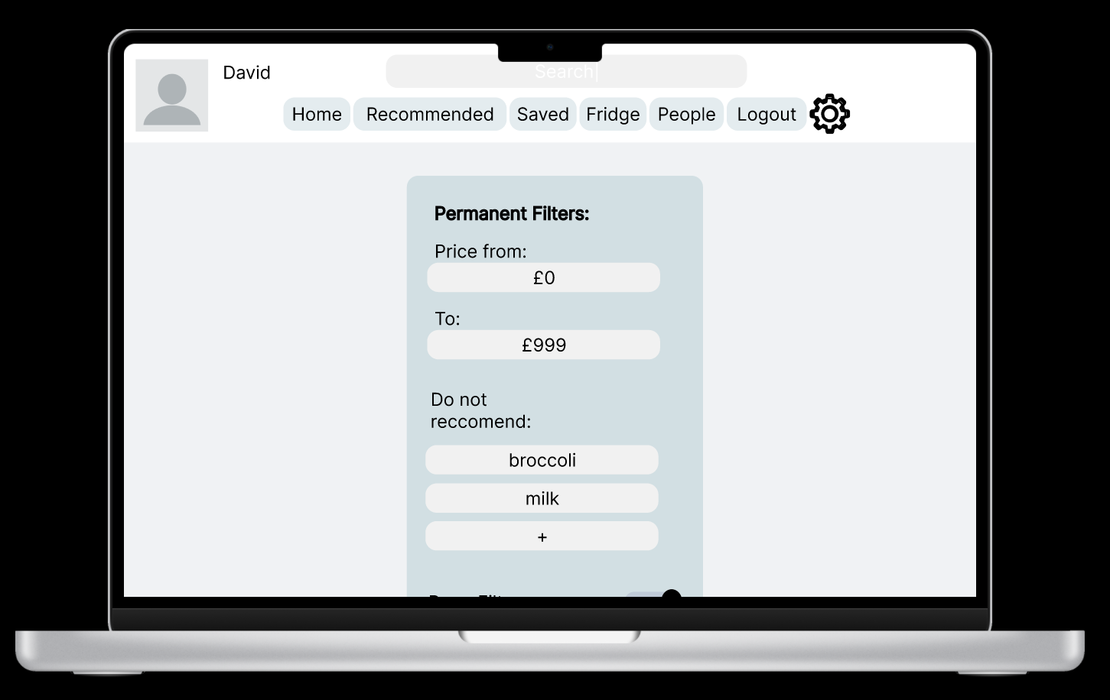
In the settings page I can add my dietary and money requirements

Slide 79
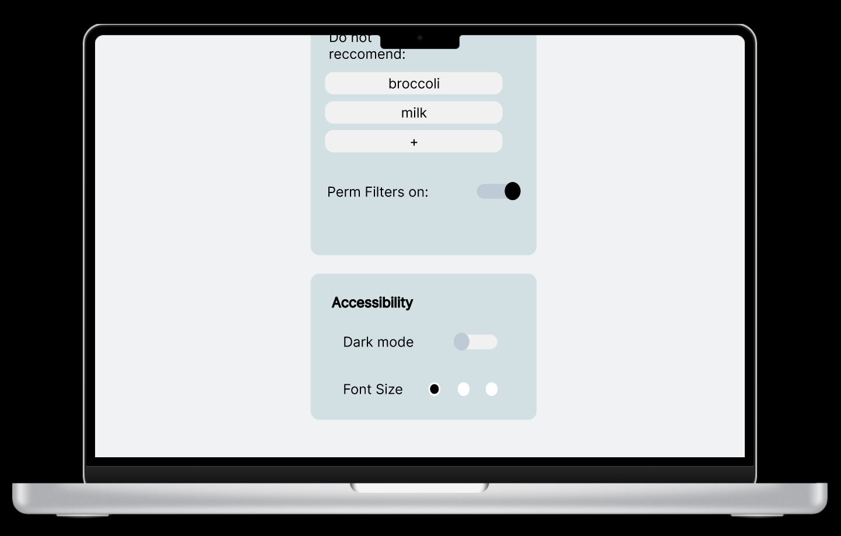
I can add ingredients to block, and enable or disable these filters in case I temporarily want to look at other recipes

Slide 80
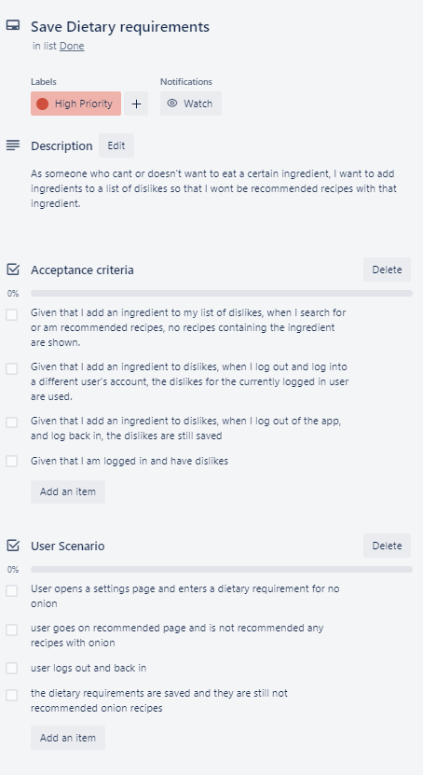
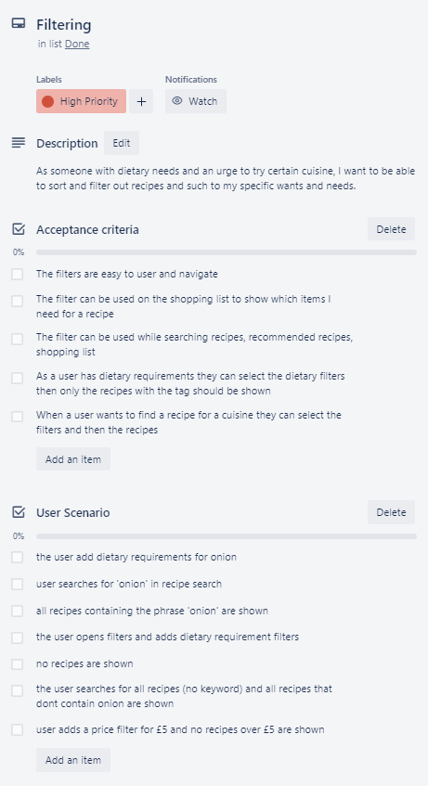

Slide 81
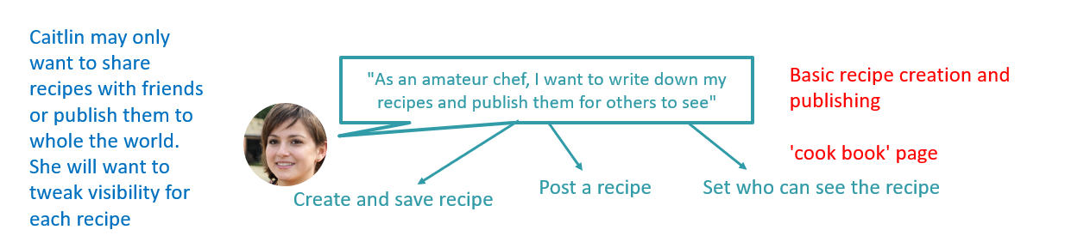
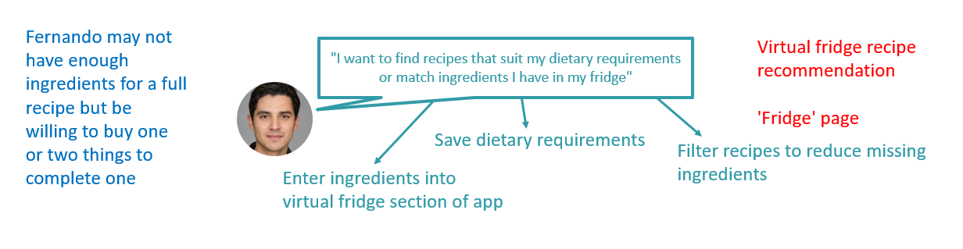
Priority epics and user stories:
- Tanika finding new recipes and Fernando filtering dietary requirements and budget
- Creating recipes needs to be added

Slide 82
In the next parts of the project please link everything to an epic and user story
E.g. This feature is needed for this epic so this person can do this

Slide 84
First priority
A key feature of our app is searching for recipes or being recommended them. Our focus for the beta sprint will be completing everything we need to start implementing this epic. Starting with login and infrastructure and then implementing what we need for the epic

Slide 86
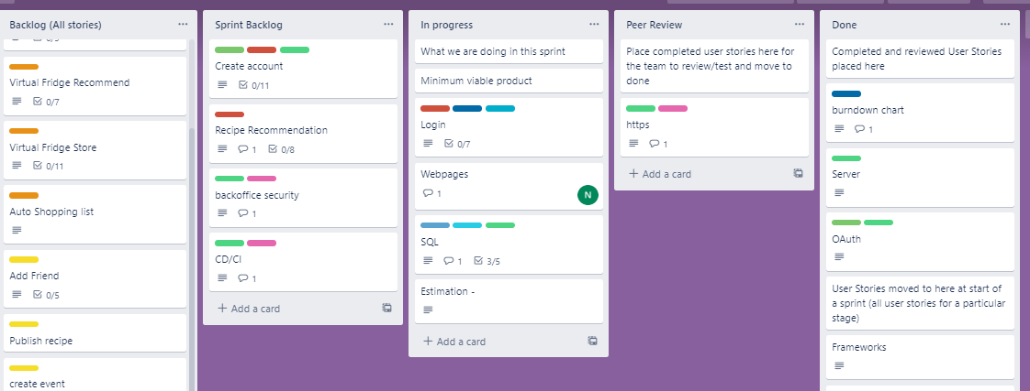
Midway through sprint

Slide 87
Mid sprint review:
When we were trying to organise our sprint we had barriers in communication and poor meeting attendance.
To improve this, everyone will need to attend all meetings and keep the group updated on their current work and any barriers.
We also identified that our kanban board needs to be updated more often so we know what is currently being done.
We will be looking at the kanban board more often in our standups from here on.
Communication has been an ongoing issue and to solve it all group members need to use the teams chat

Slide 88
Burnup:

Slide 89
TLS
TLS configuration for the application: generate private key --> certificate --> a pfx record for the kubernetes cluster to use as a secret, mounted in a volume. This enables https on the app though is currently self-signed. Will need to look into something like Certbot in a container to generate the certificates then convert them to pfx records Security important, gives sense of reliability to user, greater trust in the app, more likely to initially and continue using app when seeing https over http

Slide 90
Broken
Our login system is currently broken so we are unable to implement a user story
This is done via an OAuth api
Work cannot be done on the user stories without appropriate backend functionality.
Recipes cannot be shown without the database sql
Without the backend infrastructure progress has come to a halt on the front end.

Slide 91
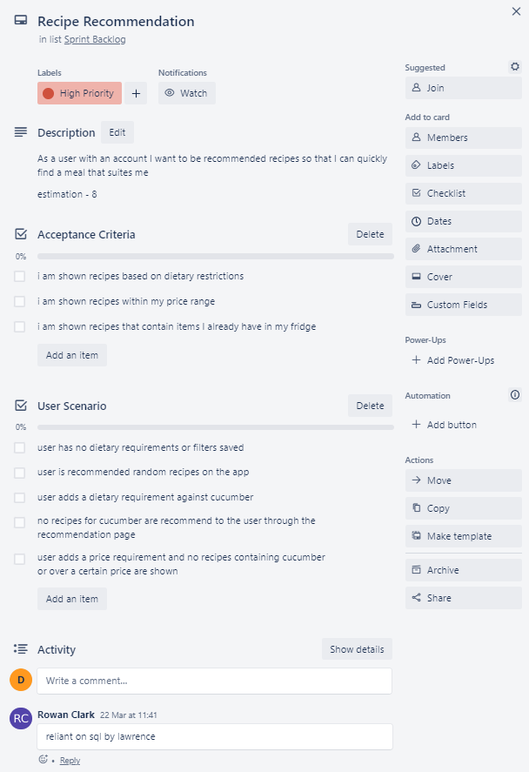
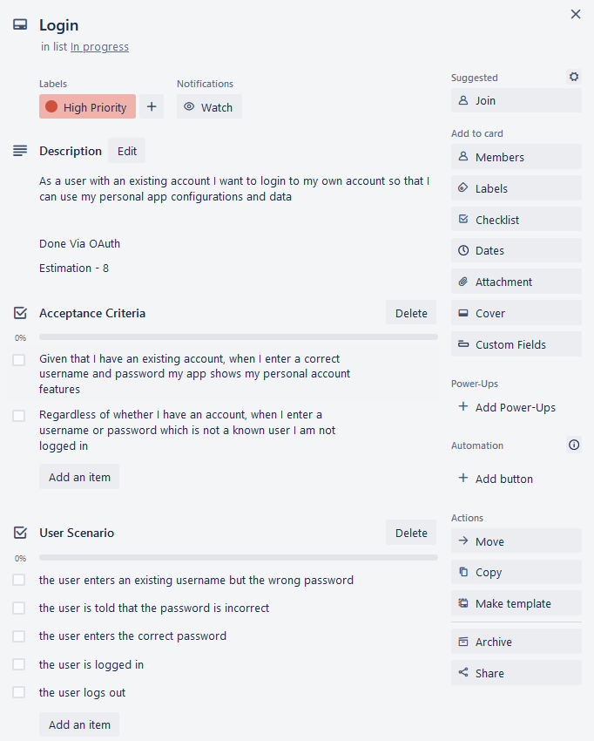

Our focus after we get all the infrastructure sorted

Slide 92


